Slide 1
Typescript for productivity
Why you should use it in every project with multiple developers
Ali Ahmed
Developer @ Punchcard Systems

Slide 2
Introduction
The purpose of this talk is to introduce the most used and most useful features of TypeScript and to show how it really shines in medium to large projects & boosts developer productivity.

Slide 3
Introduction to TypeScript
TypeScript is a superset of JavaScript that adds (optional) type annotations and, thus, static typing on top of JavaScript.
TypeScript is open-source and maintained by Microsoft.
Microsoft introduces TypeScript as “JavaScript that scales”.
Most of the JS code we write on the front-end is transpiled anyways, so why not add static type checking to the step?

Slide 4
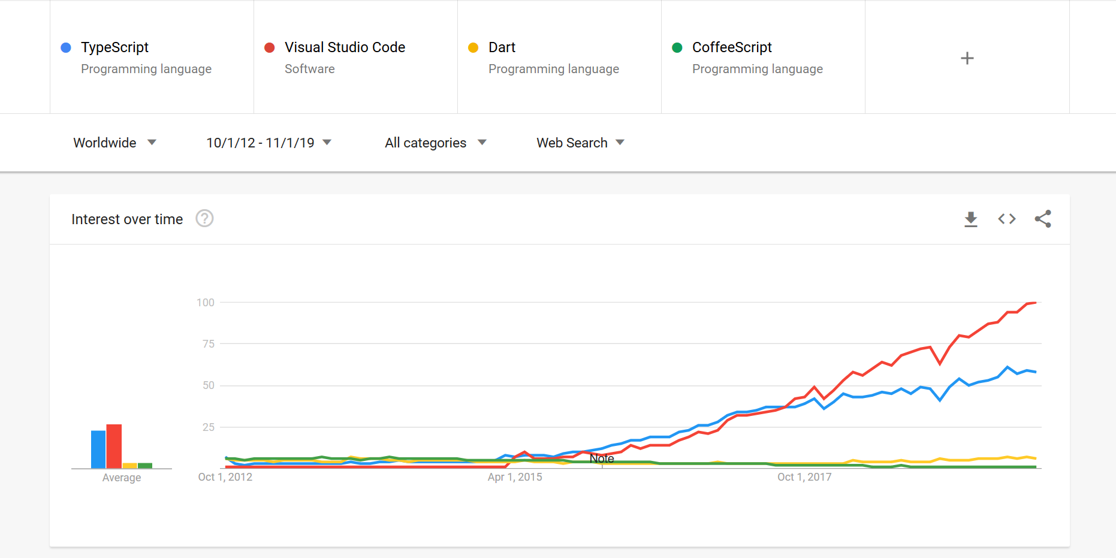
Notes:
TS first appeared on October 1, 2012
Visual Studio Code was released on April 29, 2015
Angular 2 (which adopted TS) was released in September 2016
Reference: https://trends.google.com/trends/

Slide 5
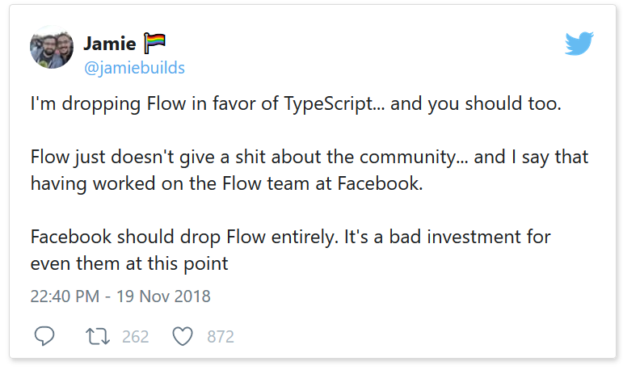
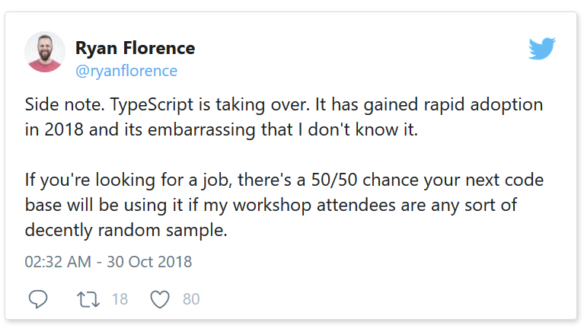
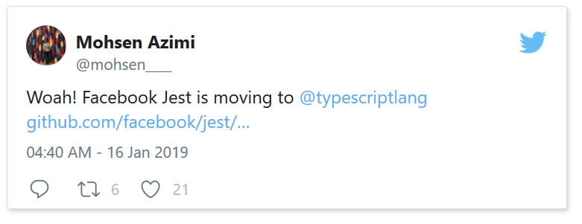
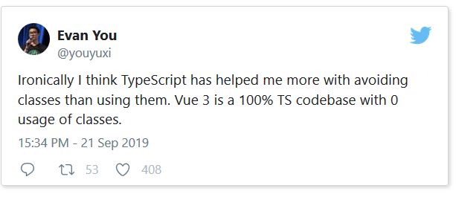
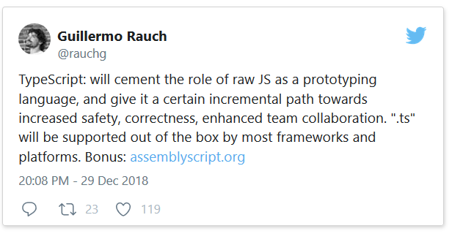
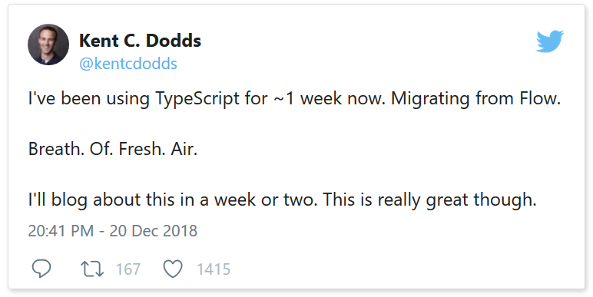
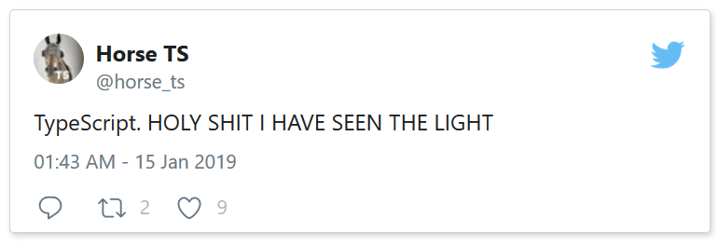
Notes:
Vue 3 now written completely in TS.
Node’s next iteration, Deno, is a JavaScript/TypeScript Runtime

Slide 6
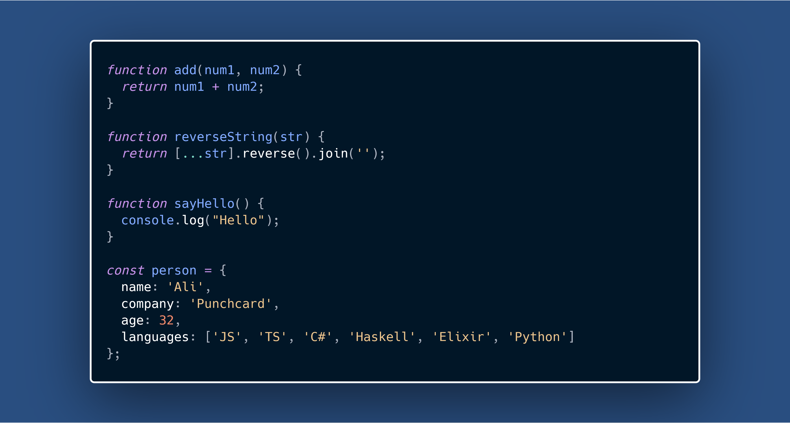
Notes:
Code Snippets thanks to https://carbon.now.sh/

Slide 7
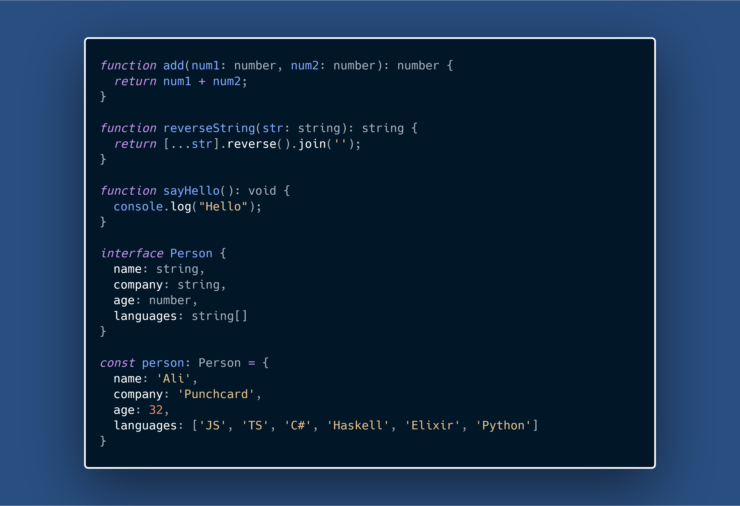

Slide 9
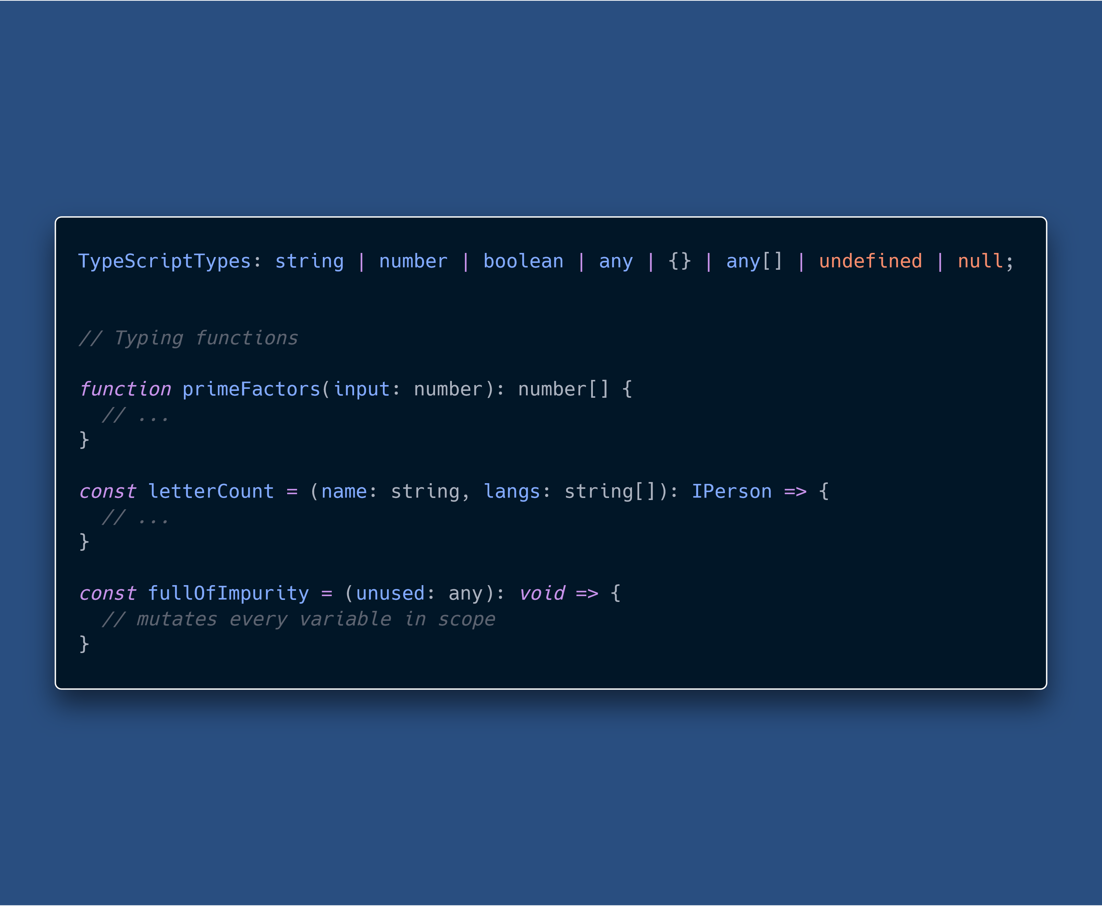
TS Basics

Slide 10
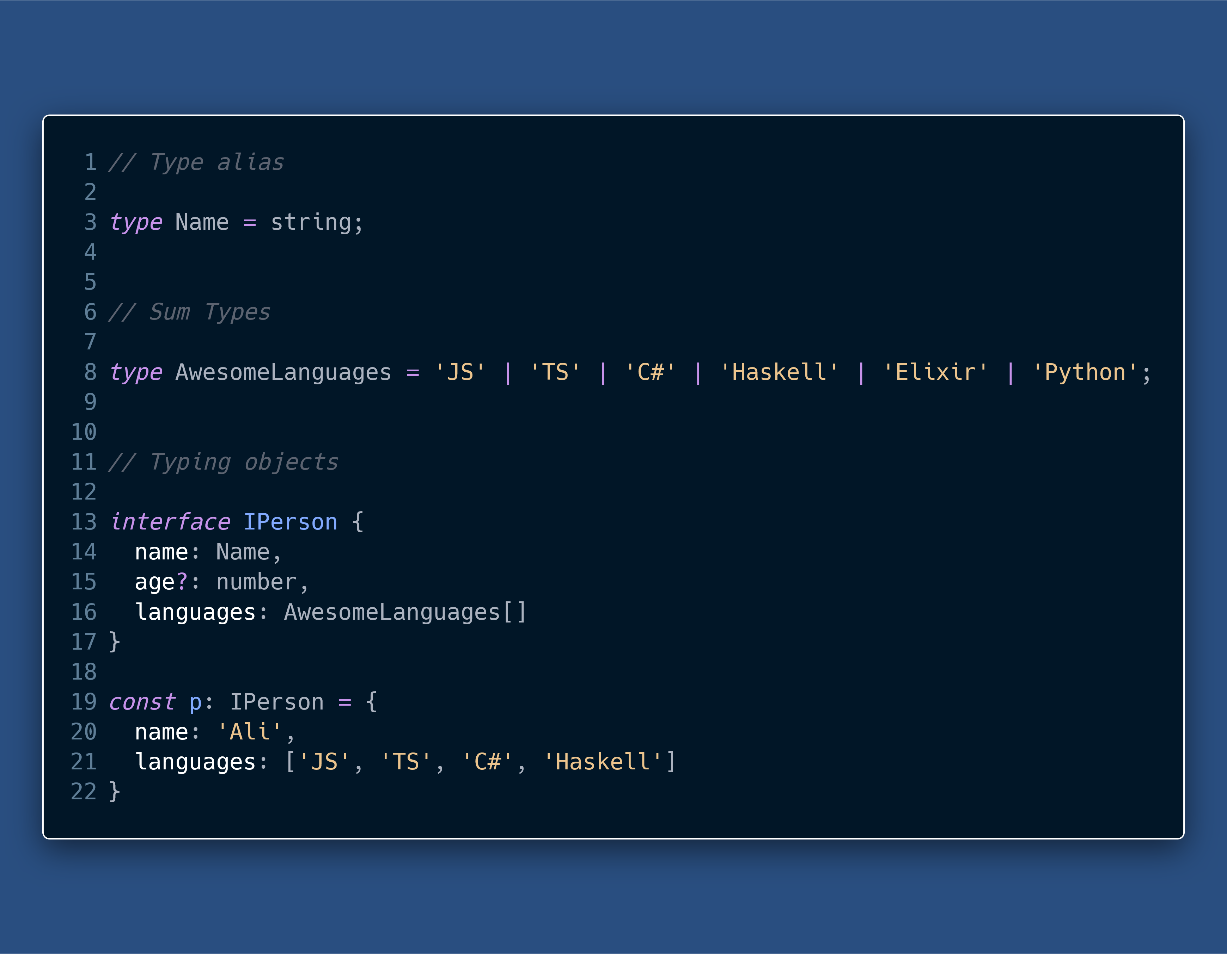
TS Basics
Notes:
Type aliases create a new name for a type
Object use duck-typing (structural typing) as opposed to nominal types.
TS also performs Excess Property Checking

Slide 11
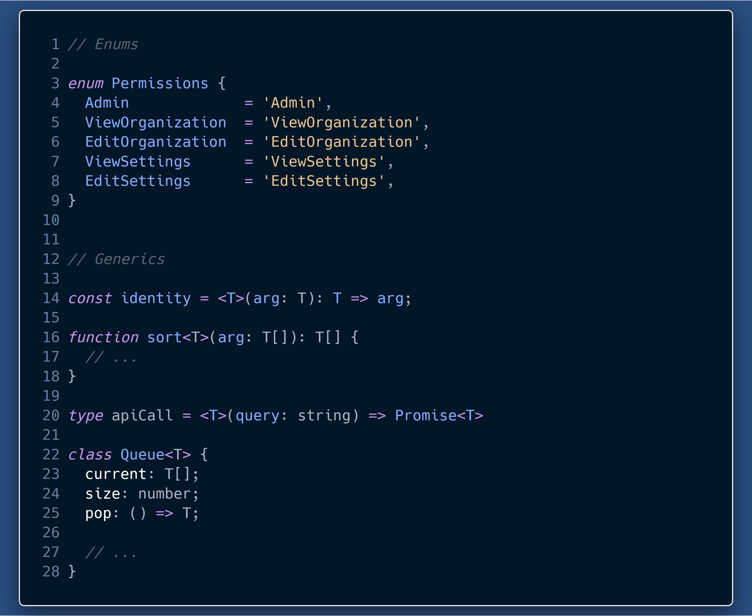
TS Basics
Notes:
Enums allow us to define a set of named constants
Generics allow us to be able to create some code that can work over a variety of types rather than one. Generics are also called polymorphic types

Slide 12
Why TypeScript ?

Slide 13
Why TS?
Readable, easily understandable and scalable code.
Self documenting code
Ease of communication among developers
Maintenance & Refactoring
Editor Superpowers
Thinking about types in our programs makes us a better developer
Static analysis and fewer run-time errors
Type Inference & Control Flow Analysis
Union Types
Closely knit with latest ECMAScript features (Stage 3+)

Slide 14
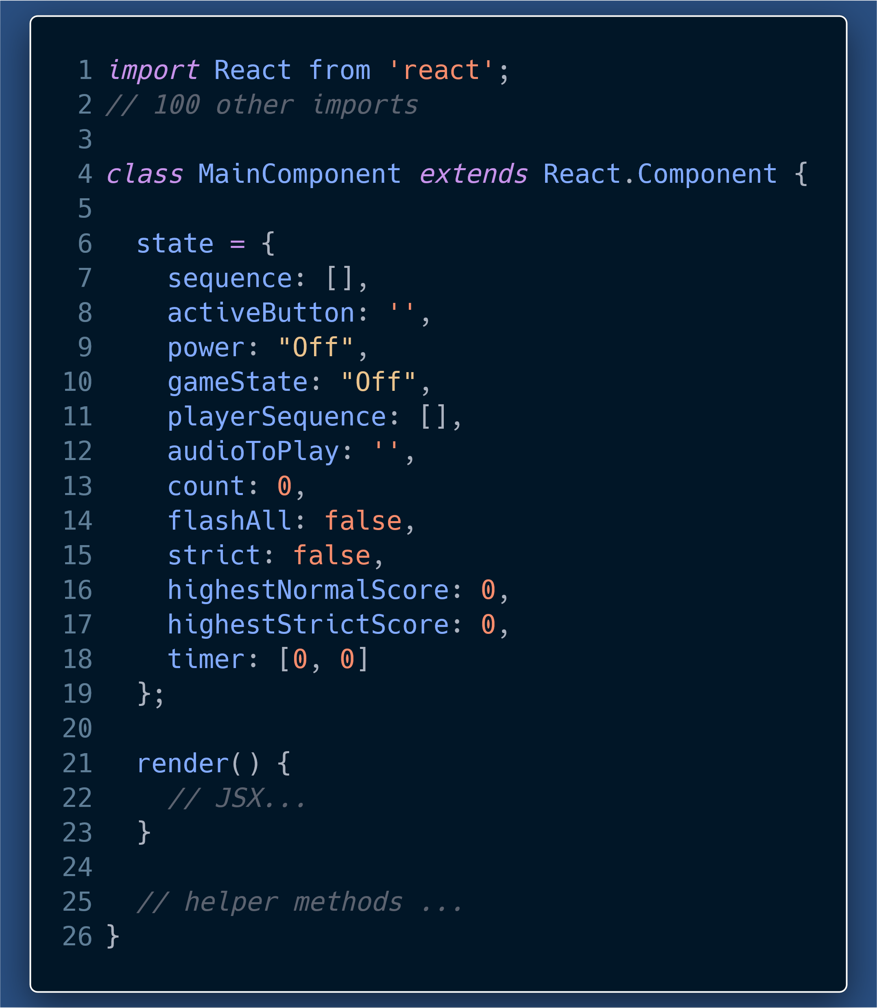
How many and what type of props does this component take?
What is each state item supposed to be?
With JSX and helper methods included, this component will be a lot harder to decipher for a first time or a long-lost reader (me after one month).

Slide 15
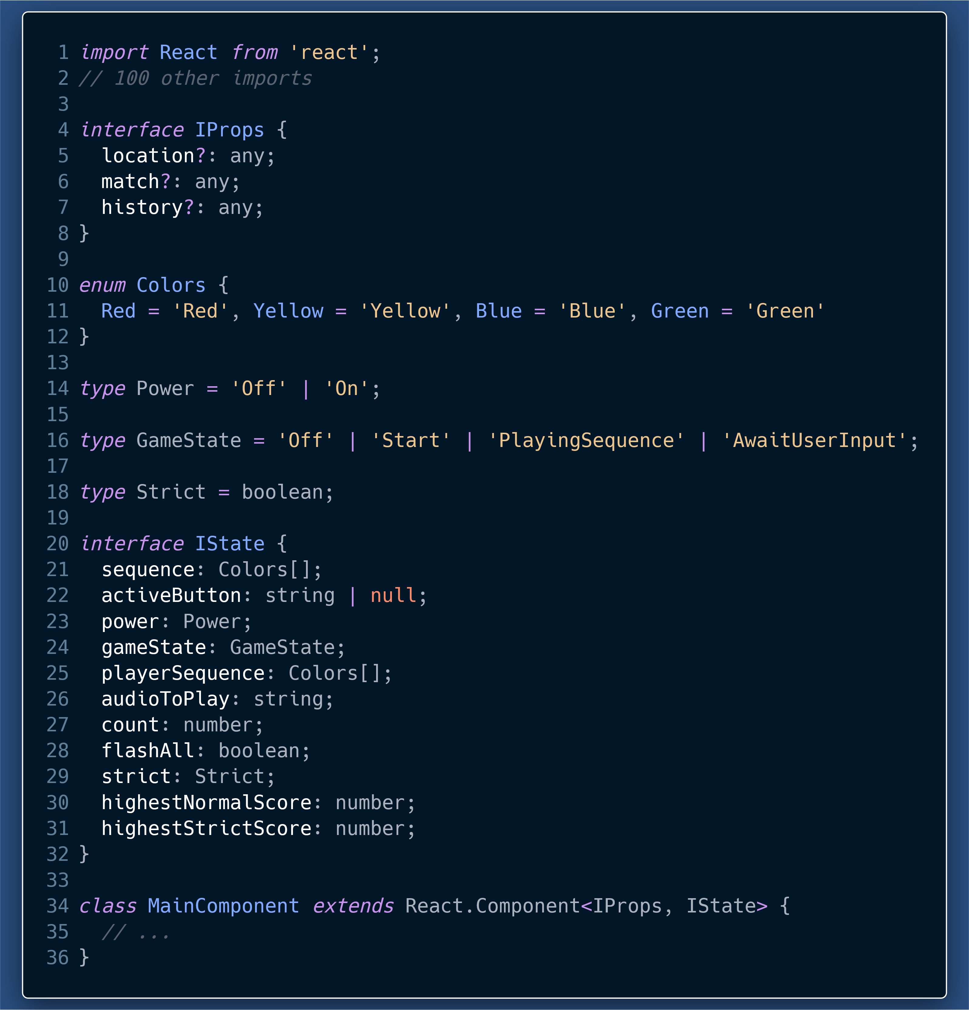
We can now clearly see the:
Exact props and types of props.
Number and types of each state property.
The best part is that the Code itself is acting as documentation.
Types add a layer of documentation on top of JS code.

Slide 16
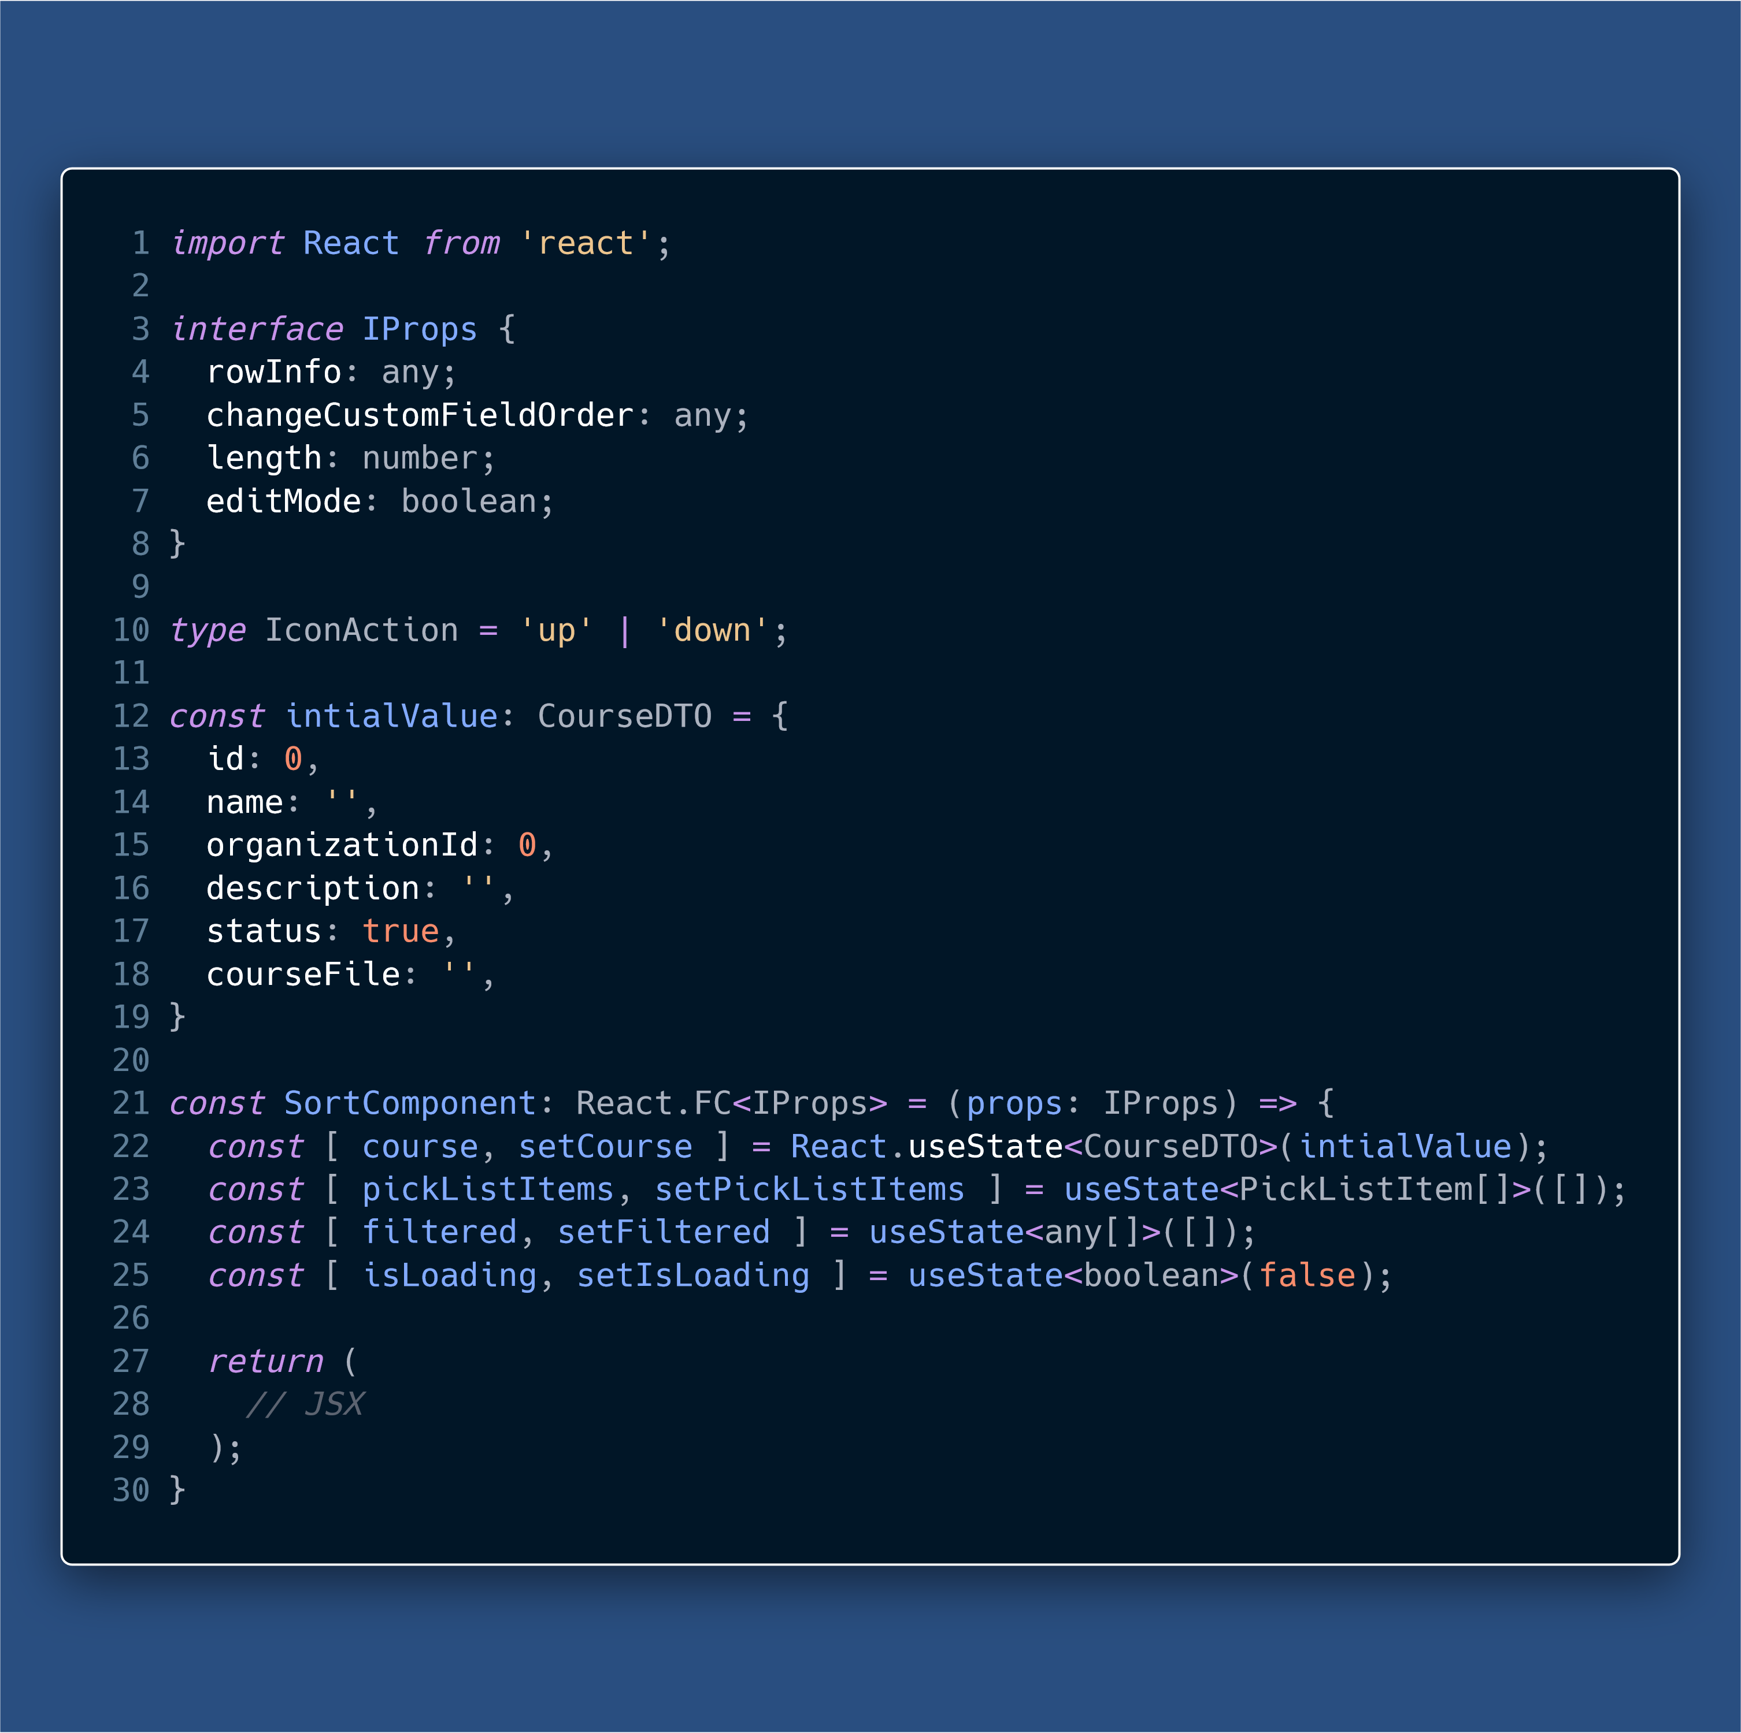
Typing Functional Components

Slide 17
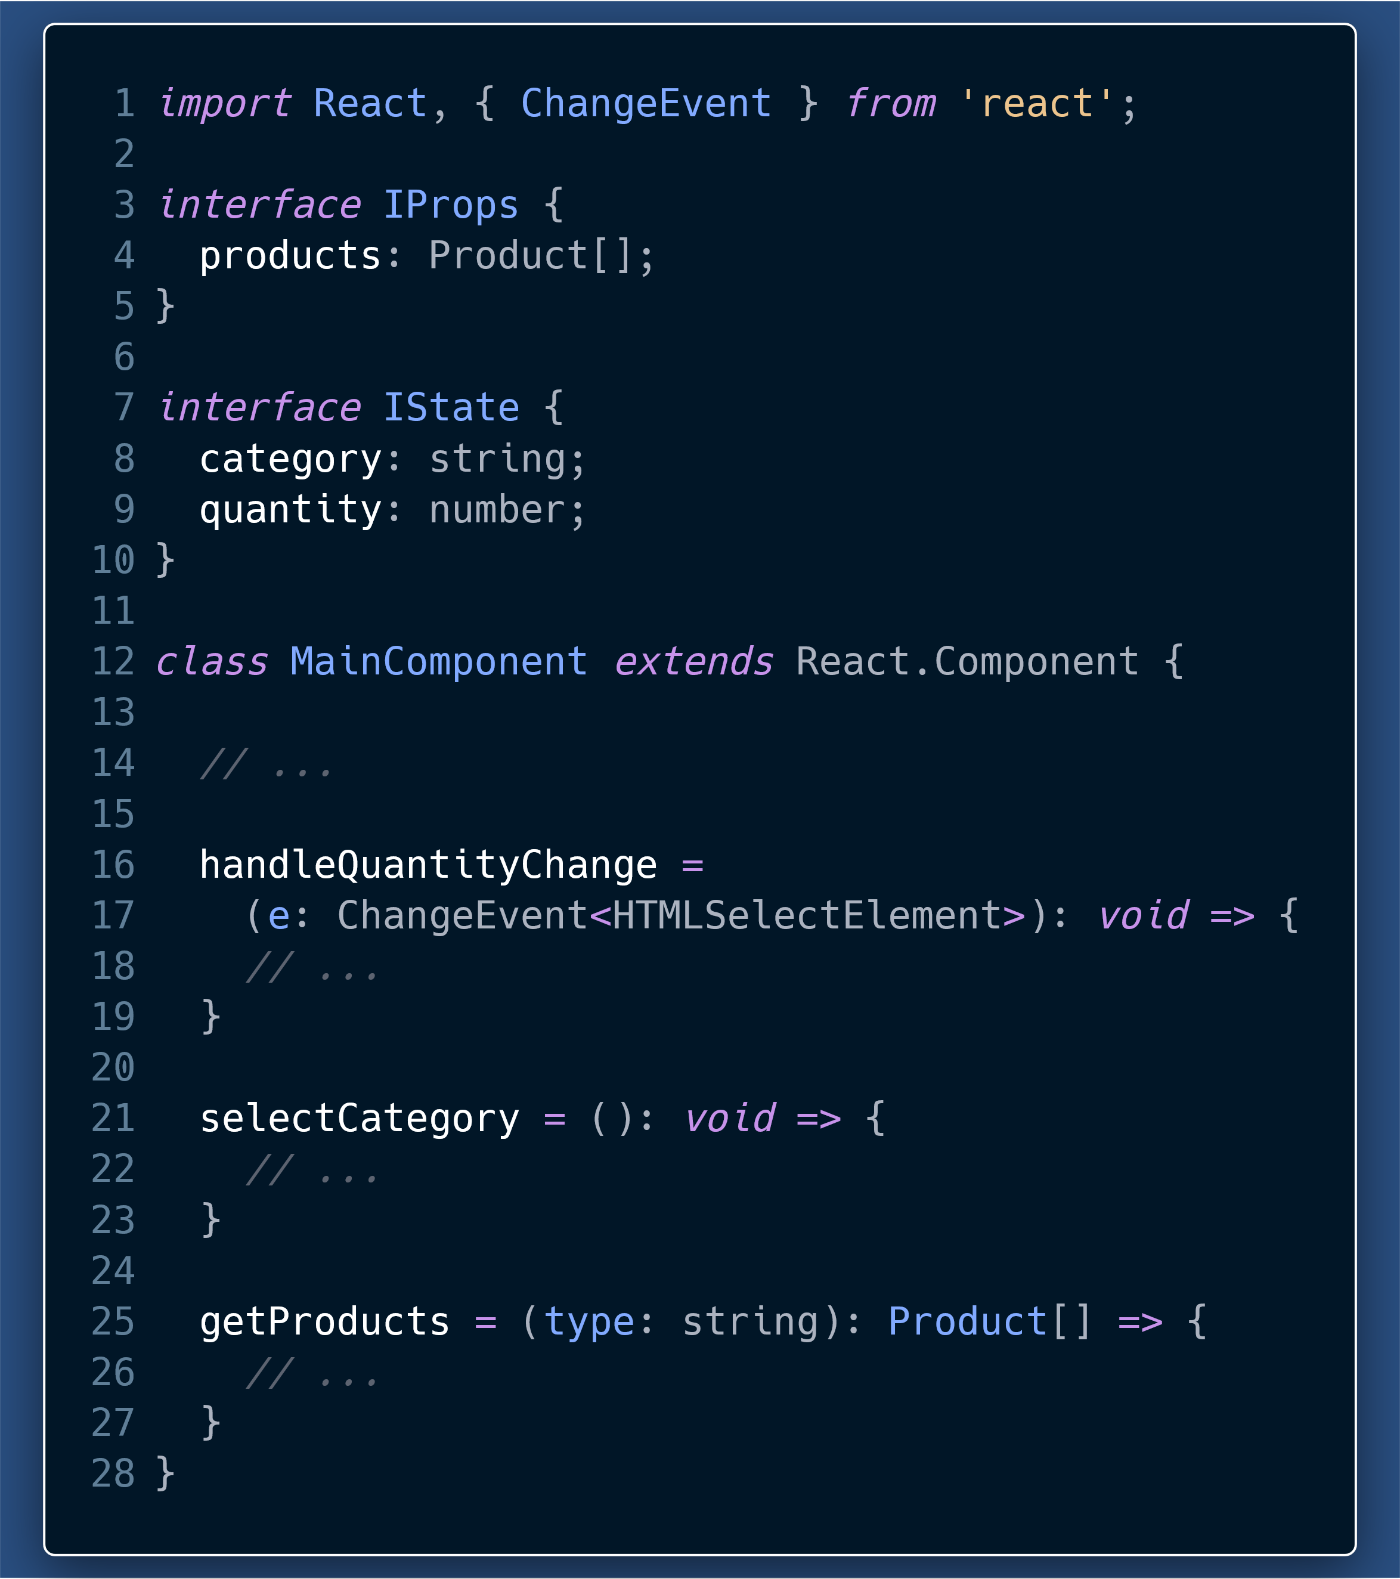
Typing your functions and helpers
promotes “Design by Contract”
Helps identify things like
The arguments a function takes, what is its return type.
Pure functions from those with side-effects.
Helps during refactoring where a developer instantly knows the purpose of a function, just from reading types.

Slide 18
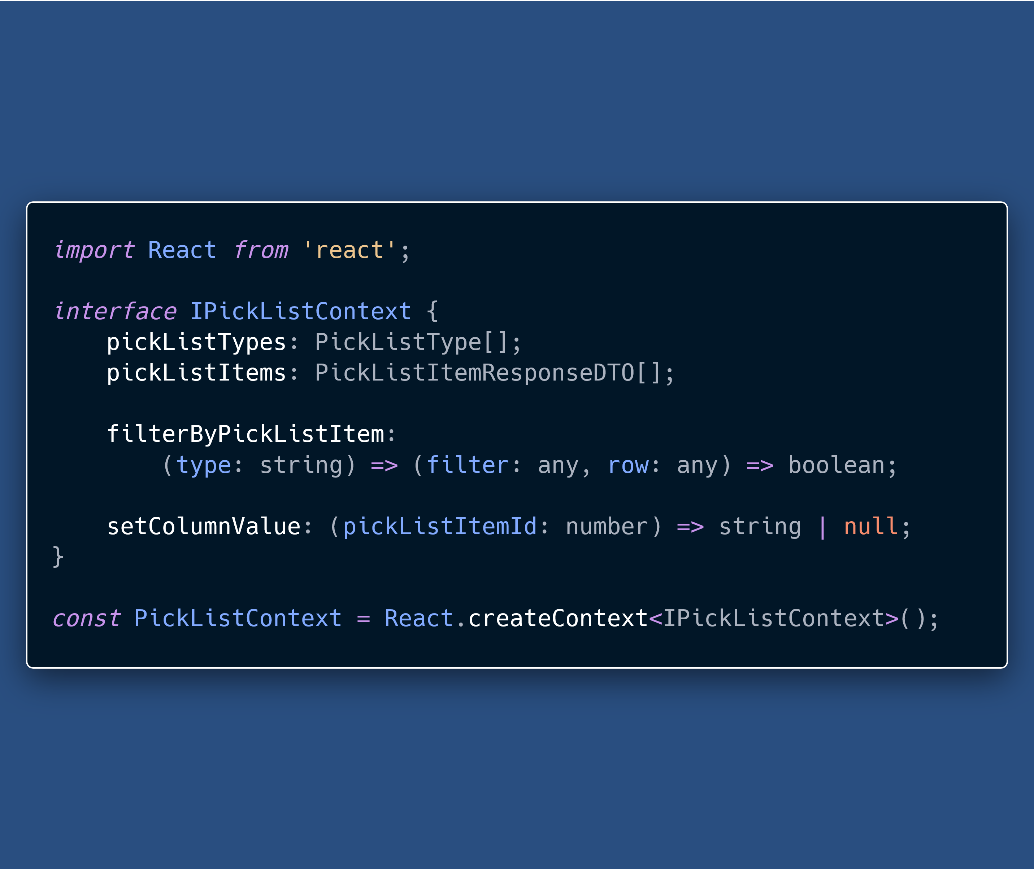
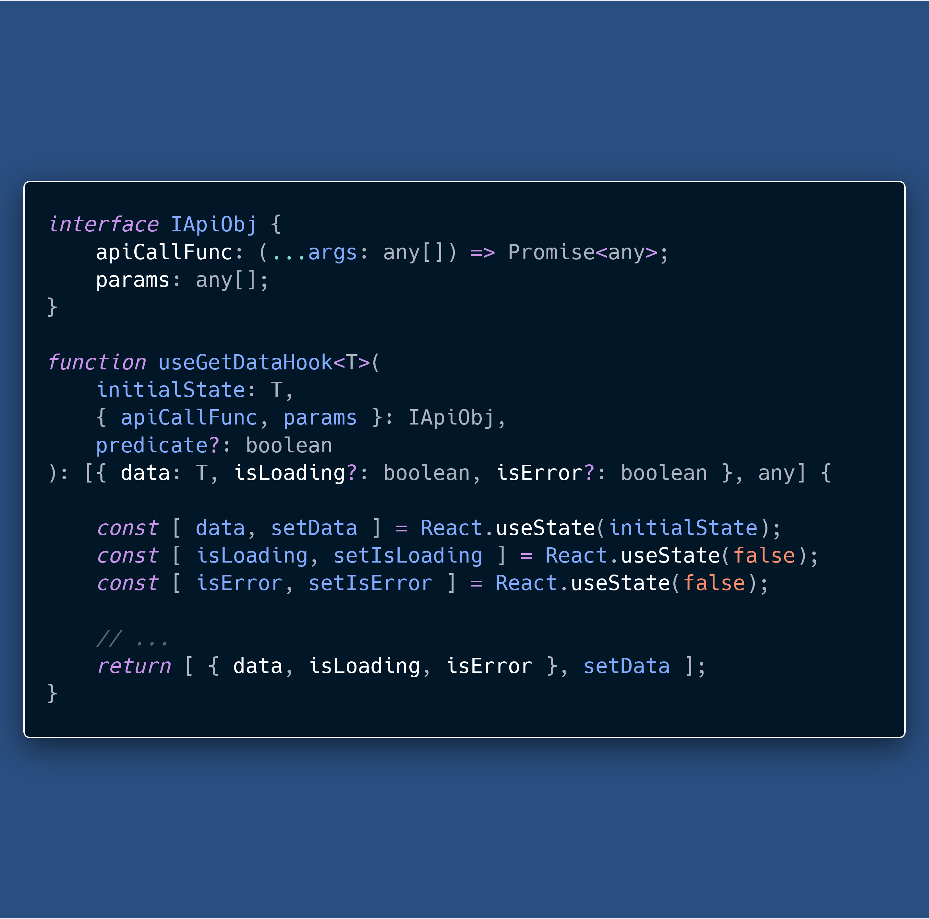

Slide 19
Run-time errors to Compile-time errors
TypeScript catches many of the errors, that would be JavaScript run-time errors, at compile time.
This works without specifying types for most of our code, because TS Compiler can infer types.

Slide 20
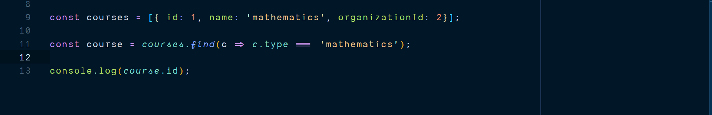
JS Run-time error to TS Compile-time error

Slide 21
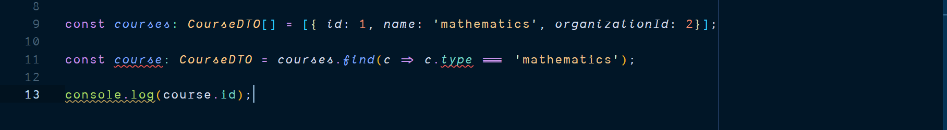
JS Run-time error to TS Compile-time error

Slide 22
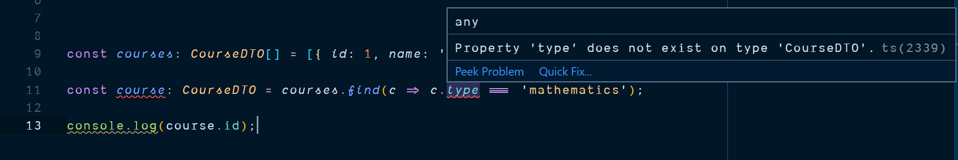
JS Run-time error to TS Compile-time error

Slide 23
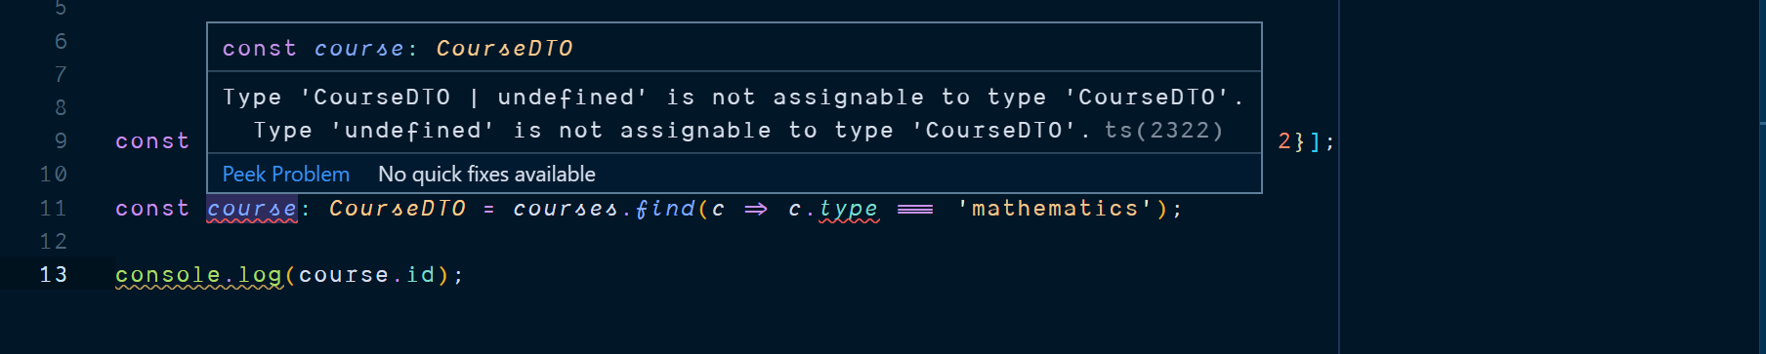
JS Run-time error to TS Compile-time error

Slide 24
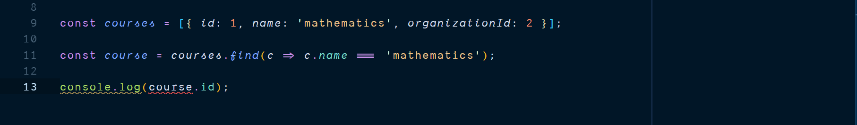
JS Run-time error to TS Compile-time error

Slide 25
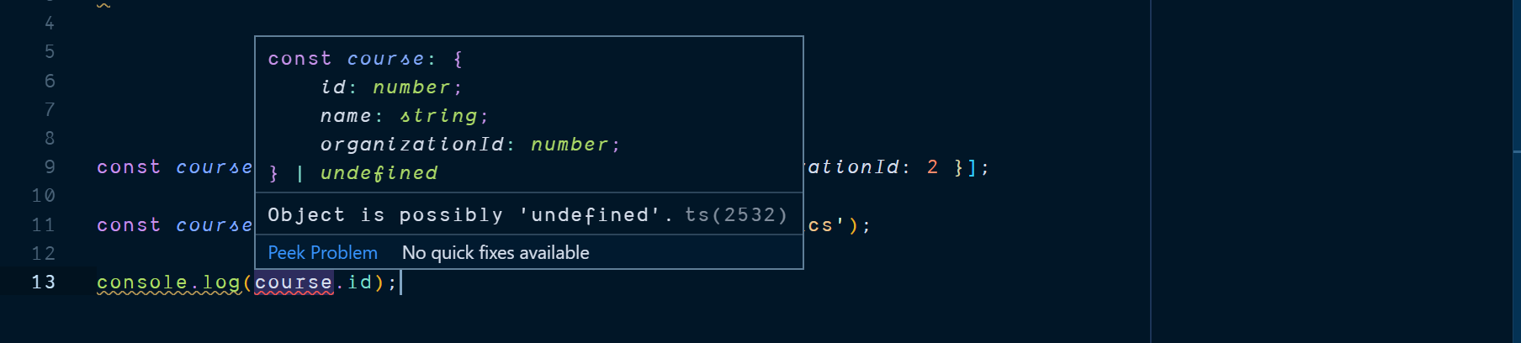
JS Run-time error to TS Compile-time error

Slide 26
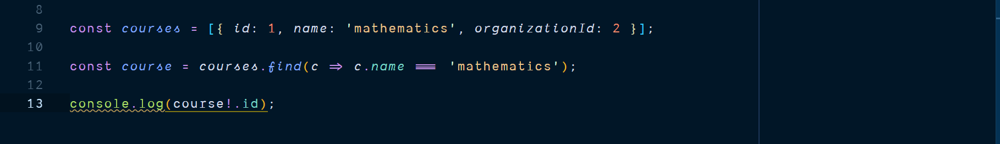
JS Run-time error to TS Compile-time error
Notes:
assertions

Slide 27
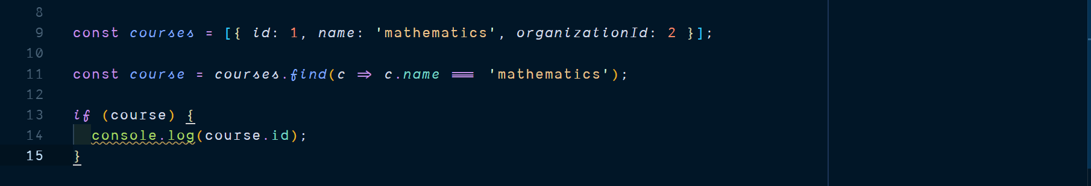
JS Run-time error to TS Compile-time error
Notes:
Add Type Guards as well

Slide 28
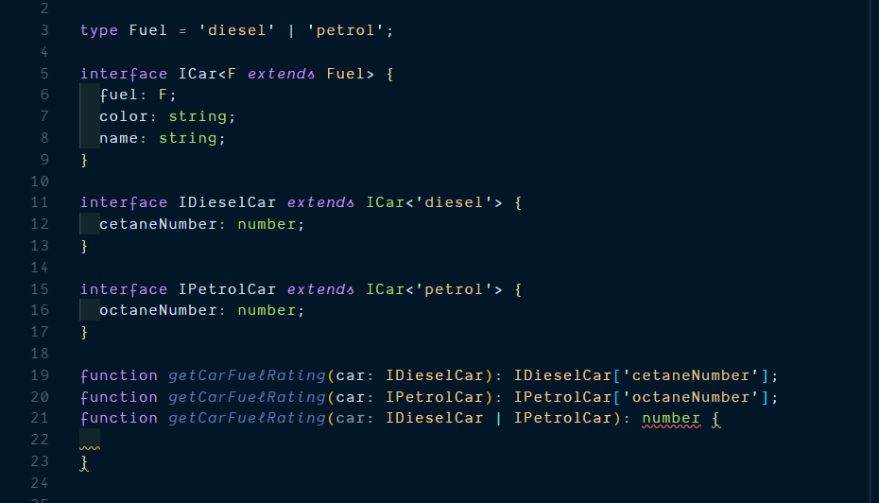
Function overloads and Type Guards
Notes:
All interfaces are objects, not classes.
Reference: https://codesandbox.io/s/fu7s4

Slide 29
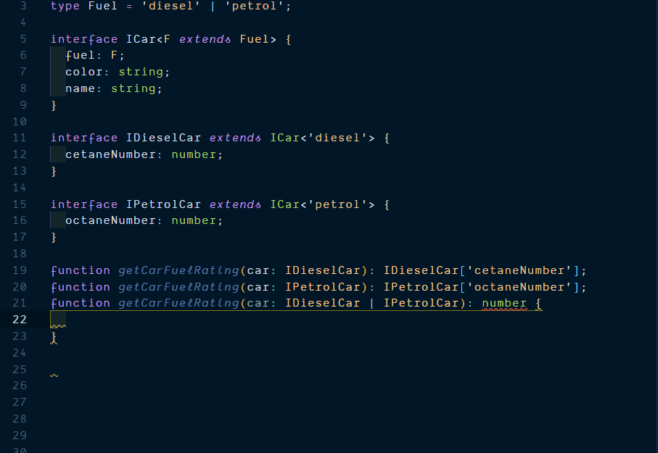
Notes:
Reference: https://codesandbox.io/s/fu7s4

Slide 30
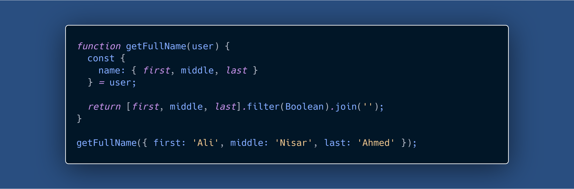
Notes:
https://kentcdodds.com/blog/eliminate-an-entire-category-of-bugs-with-a-few-simple-tools

Slide 31
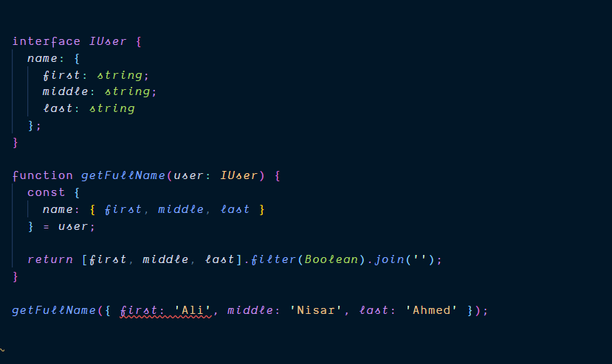
Notes:
https://kentcdodds.com/blog/eliminate-an-entire-category-of-bugs-with-a-few-simple-tools

Slide 32
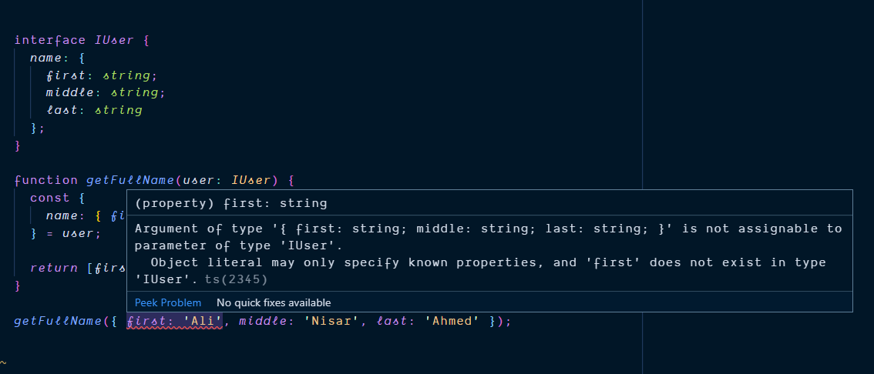
Notes:
https://kentcdodds.com/blog/eliminate-an-entire-category-of-bugs-with-a-few-simple-tools

Slide 33
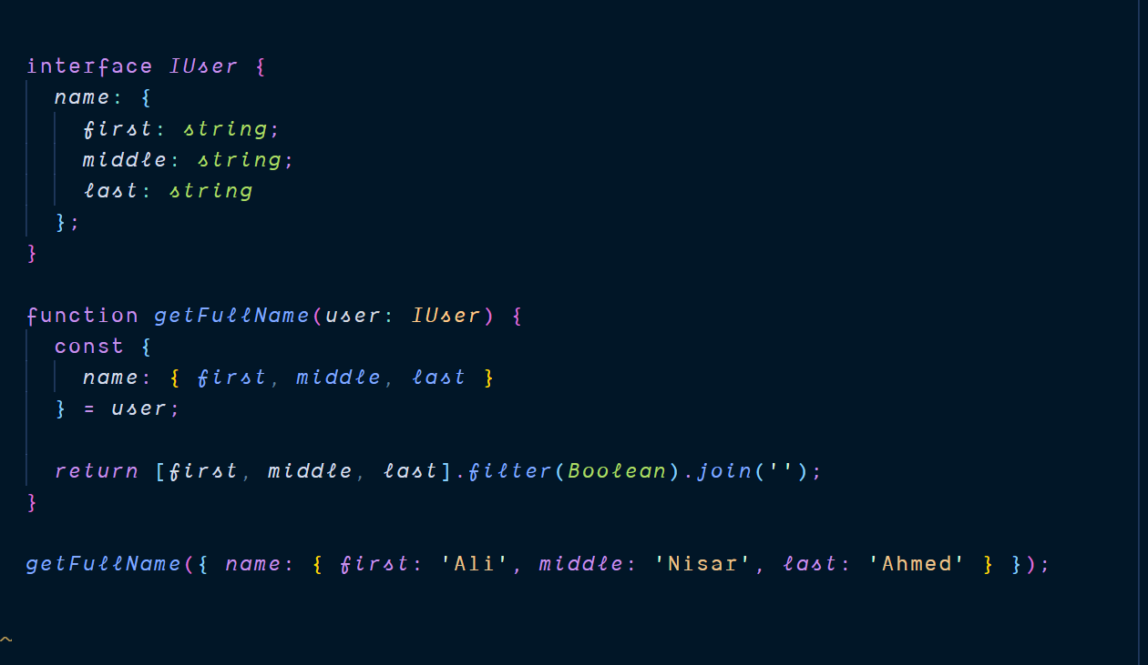
Notes:
https://kentcdodds.com/blog/eliminate-an-entire-category-of-bugs-with-a-few-simple-tools
Notice, no typing on the input object, an example of structural typing, as long as name, number and types of properties of two objects match, they are of same type.

Slide 34
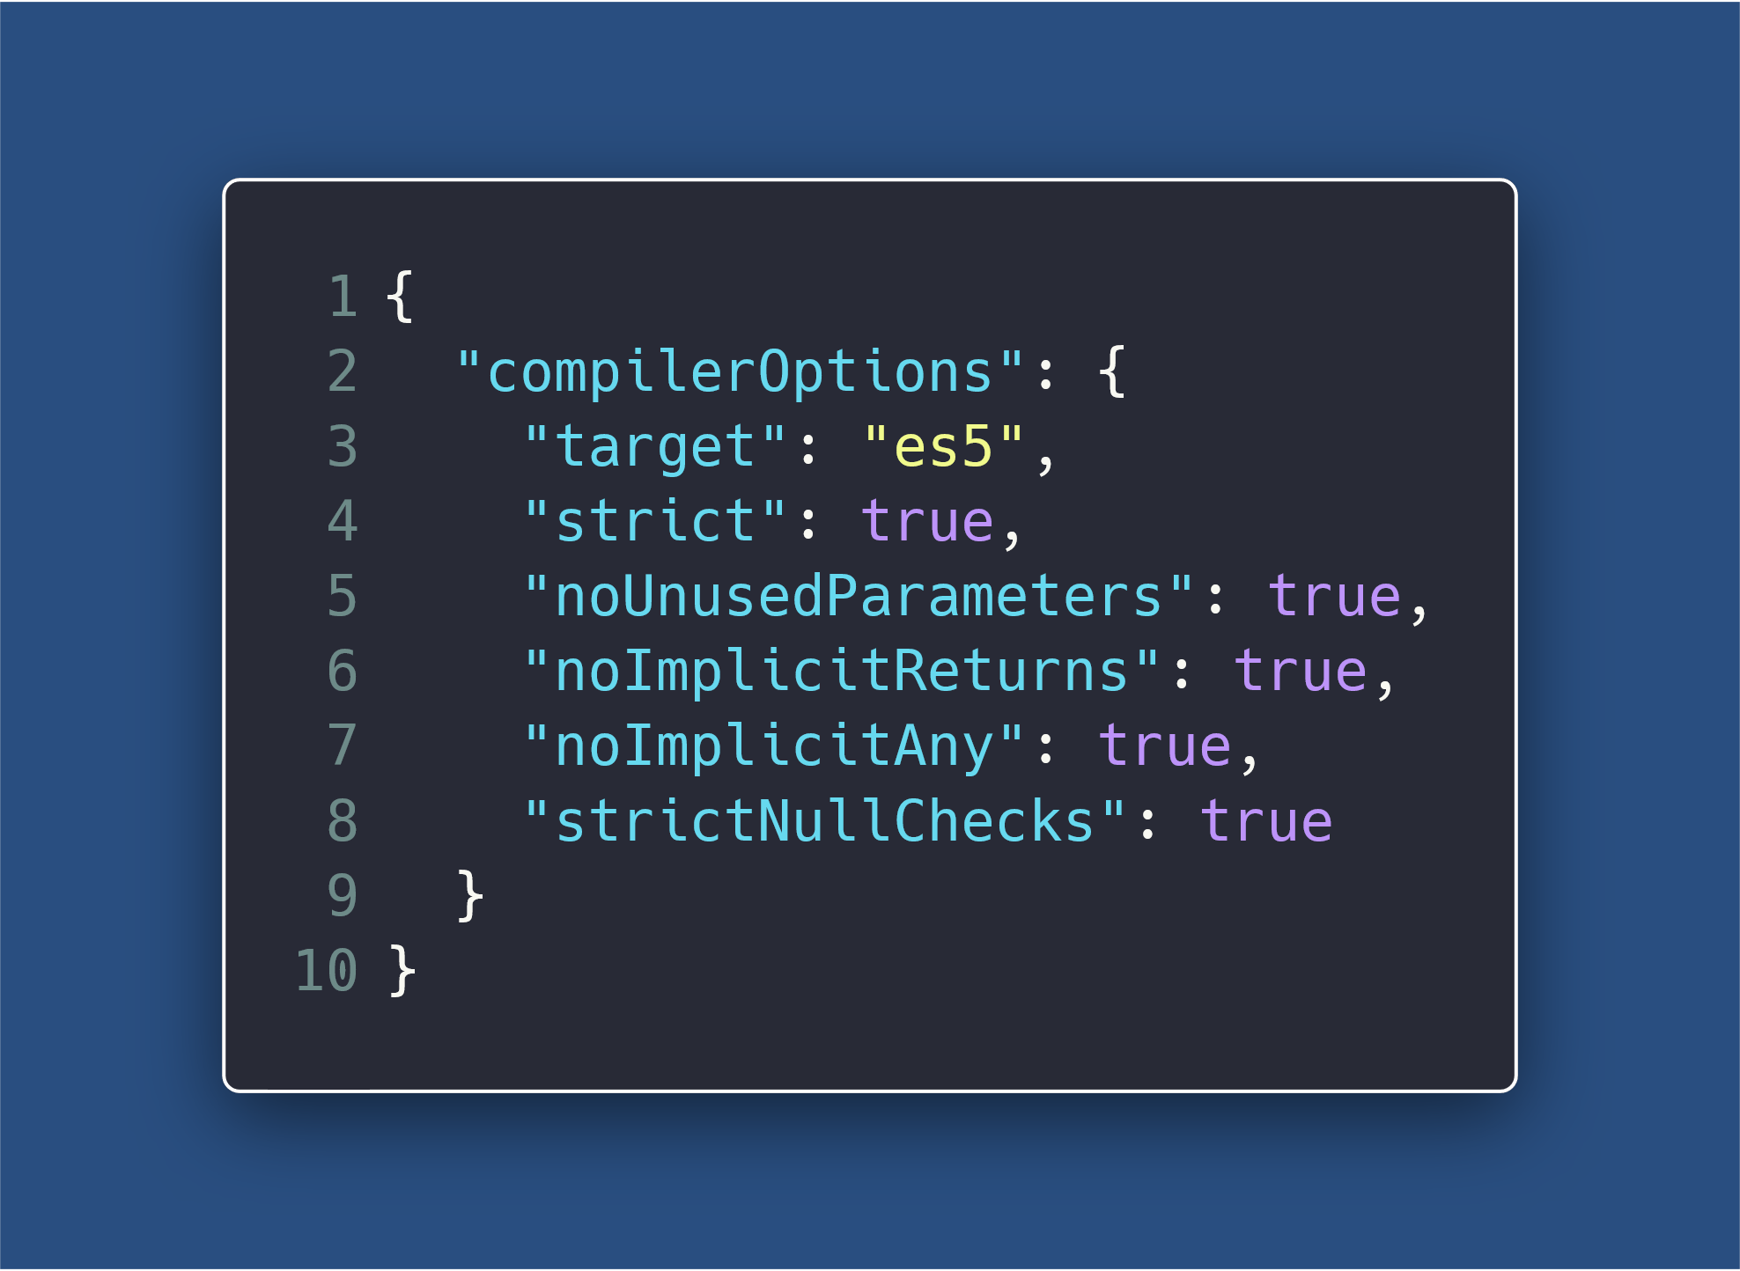
Notes:
allowJS and checkJS TS compiler options
--strictFunctionTypes
Explain –strict

Slide 35
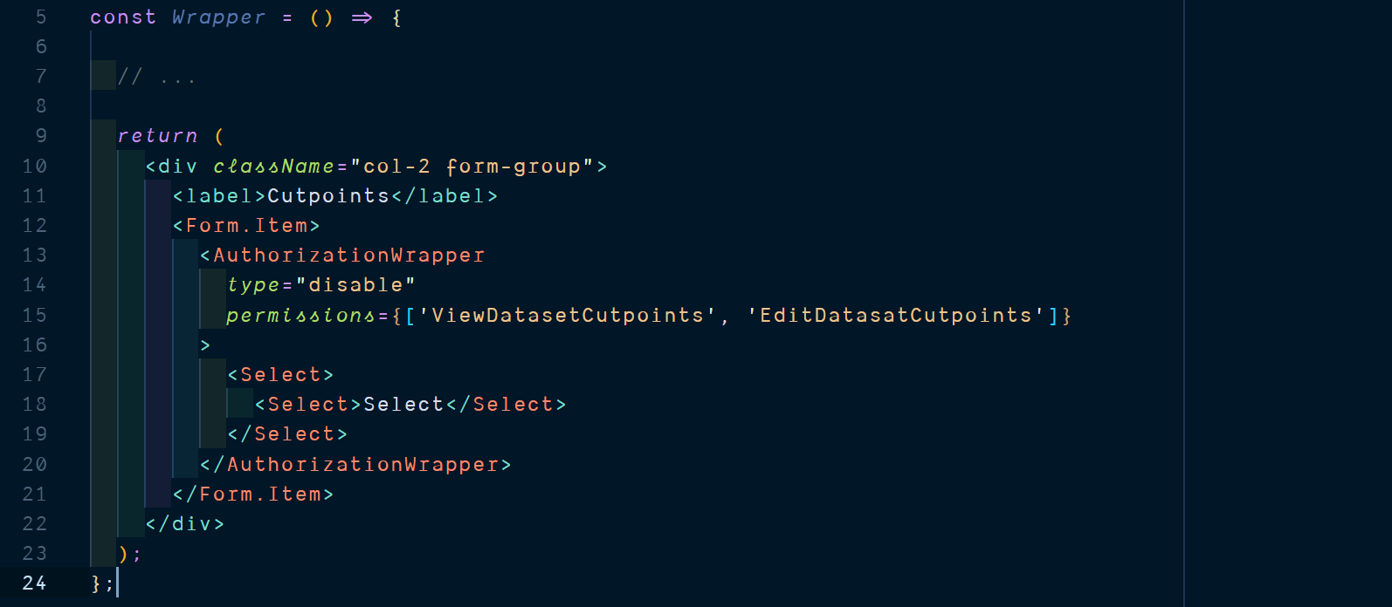
Notes:
Focus is on Authorization Wrapper
There is a typo on the permissions string literals.

Slide 36
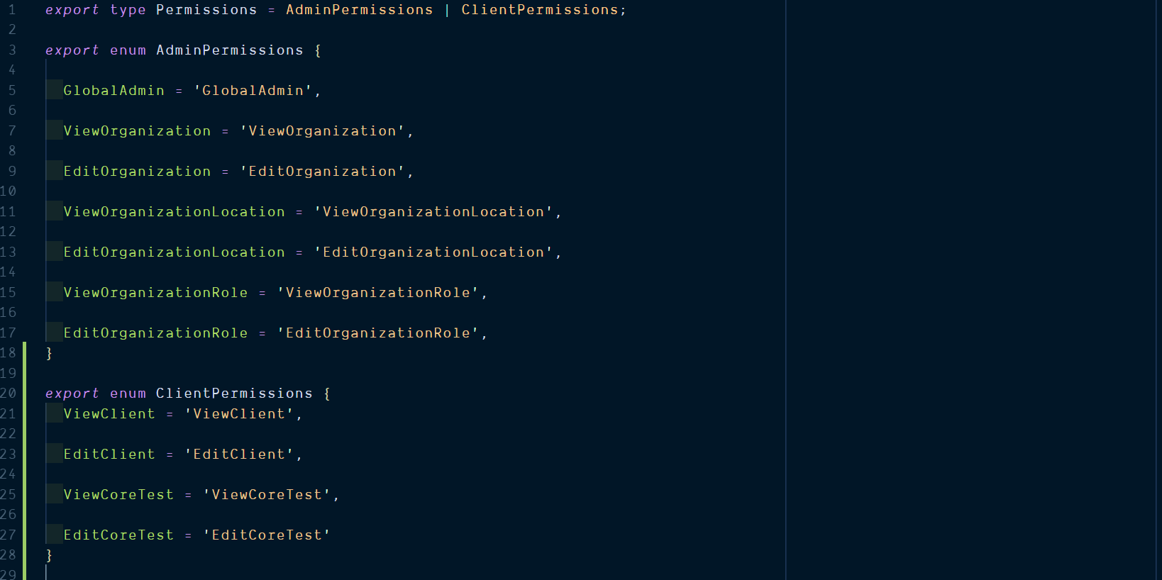

Slide 37
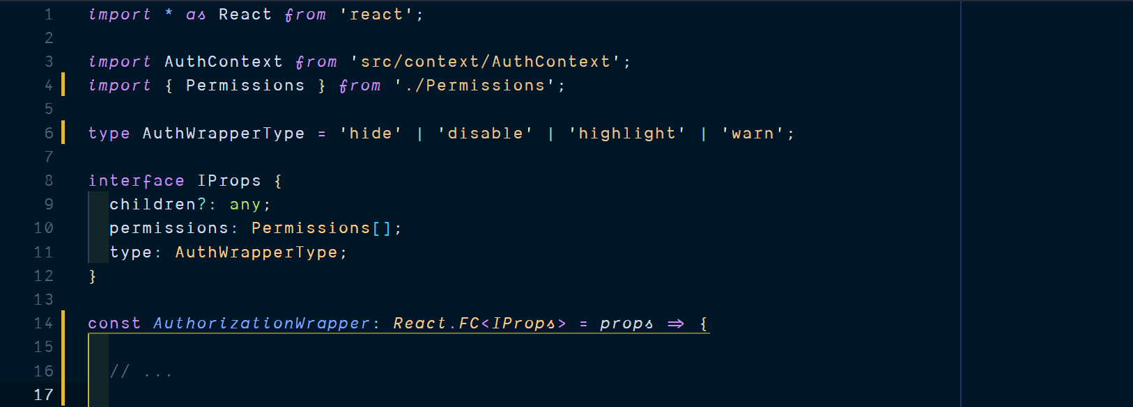

Slide 38
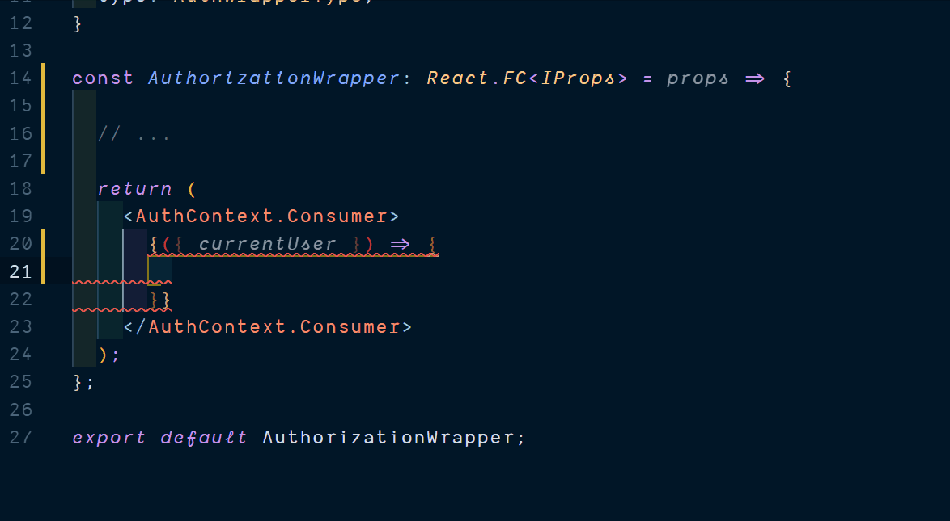

Slide 39
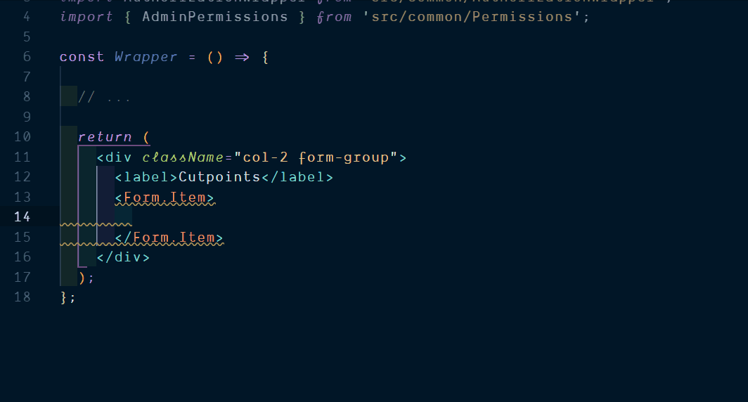

Slide 40
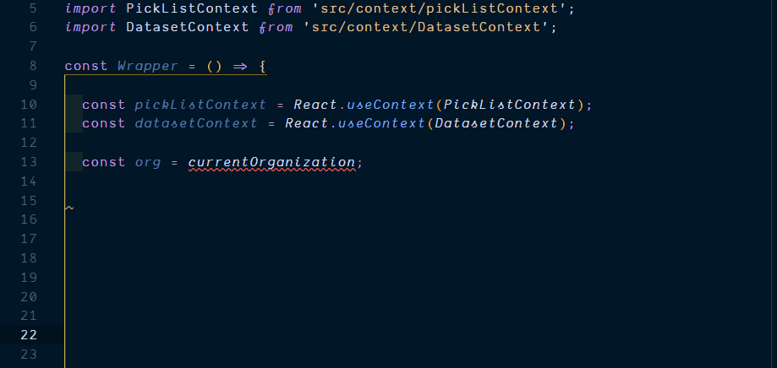

Slide 41
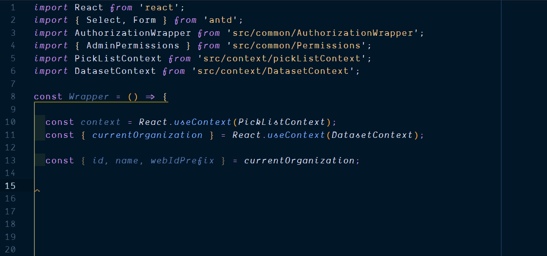

Slide 42
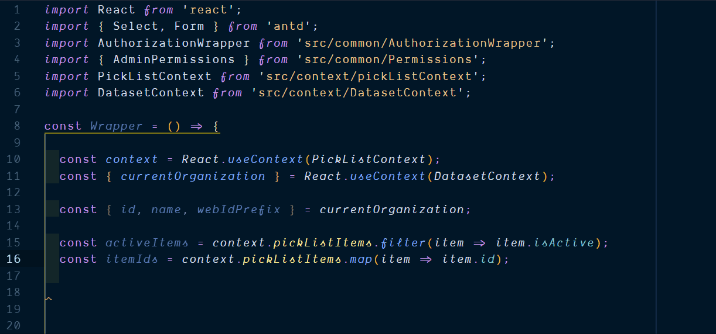

Slide 43
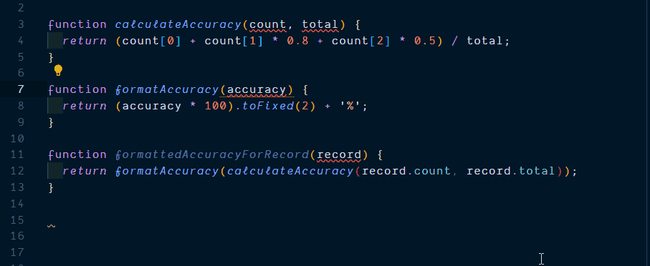
Notes:
Demonstrates how VSCode is able to infer types, using TS. Editor as our ally

Slide 44
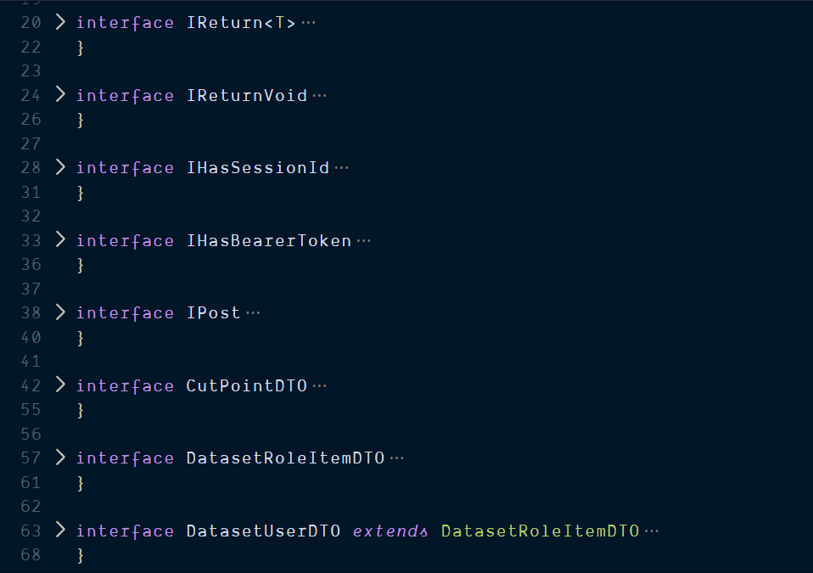

Slide 45
Oft quoted TS criticisms
Learning curve
Conflicts with existing libraries
Just another fad
It’s basically JS types with a few new concepts
Thanks to DefinitelyTyped
Nopes
Notes:
3. With the upcoming wasm, it prepares JS for the future, actually. May well be the best thing to happen to JS.
4. Type system is not sound.
5. Babel now transpiles TS to JS

Slide 46
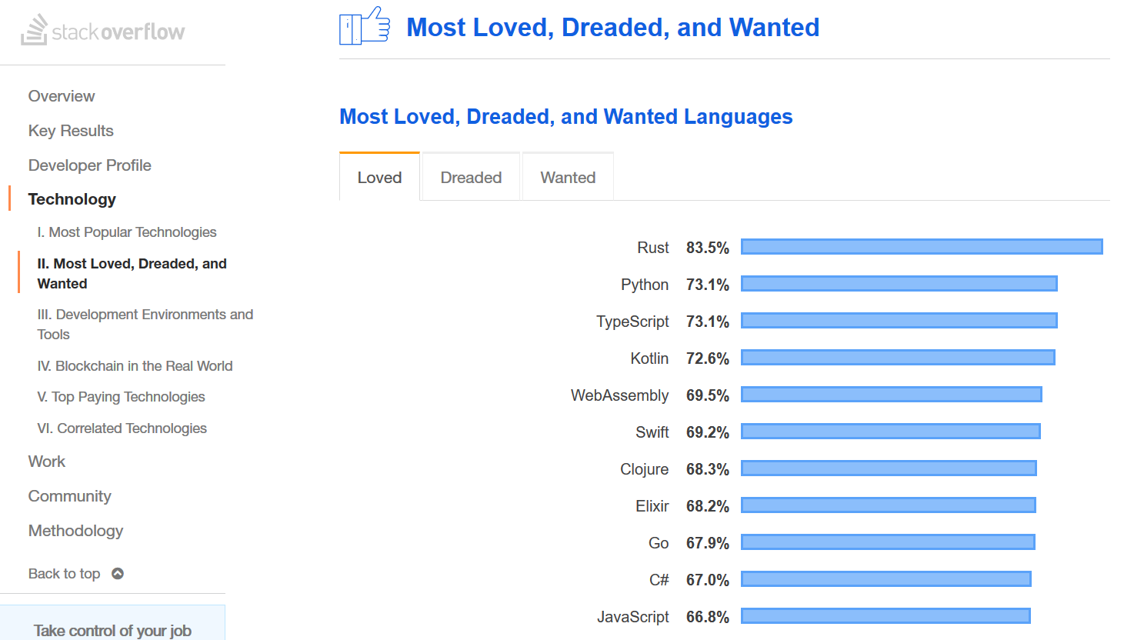

Slide 47
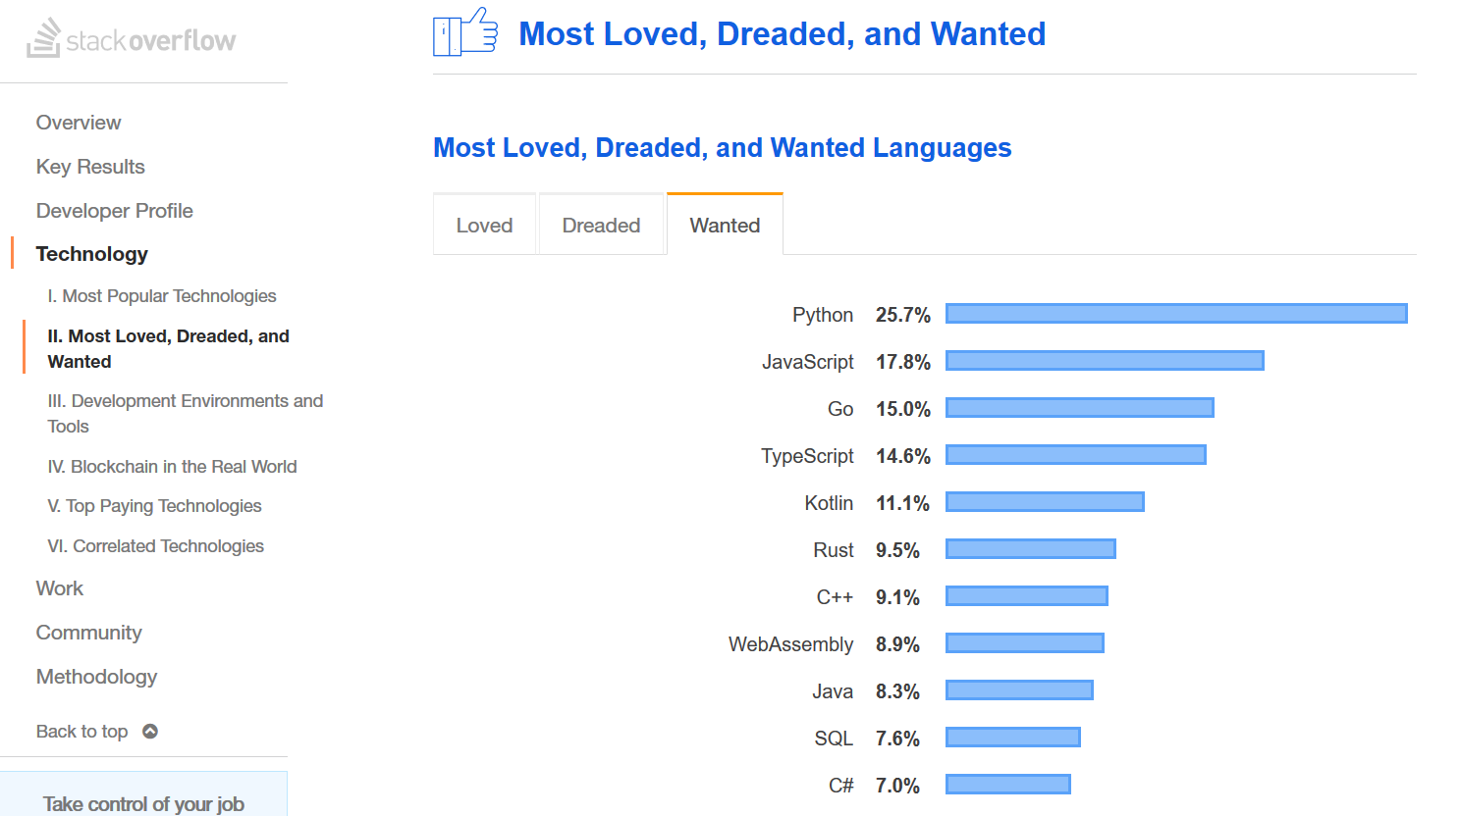

Slide 48
Oft quoted TS criticisms
Learning curve
Conflicts with existing libraries
Just another fad
Does not eliminate 100% run-time errors.
Complicated Error messages.
Difficult initial setup & migration.
Does not obviate the need for Testing, Code Reviews etc.
Other tools available (like JSDoc, Flow, PropTypes)
Deviating too much from JS.
It’s basically JS types with a few new concepts
Thanks to DefinitelyTyped
Nopes
Notes:
3. With the upcoming wasm, it prepares JS for the future, actually. May well be the best thing to happen to JS.
4. Type system is not sound.
5. Bebel now transpiles TS to JS
Add other tools, JSDoc, Flow,
Add: does not obviate the need for Testing, Code Reviews etc.

Slide 49


Conclusion
What TS gives us:
Static code analysis
Self documenting code
Union Types & Generic Types
Easy to read and reason code
Easy to maintain and refactor code
Latest ES features
What TS does not give us
Immutable values & Data Structures
Pure functions with contained side effects
Minimal shared state
Zero run-time errors guarantee
Notes:
Should we just ditch JS altogether? Should we rename exchangeJS to exchangeTS? TS to me is more like an extension to JS, a DLC, rather than a stand-alone game

Slide 50
Thank you! Questions & Comments?

